Slide 1



SAP HANA技术交流

Slide 2

SAP HANA基础知识概览

Slide 3
重构企业管理软件套件
问题（于2006年） : ，在R/3发布的14年后, 如果从头开始重新构建一套企业管理软件系统，它应该是什么样子的？
所有的活动数据都处于内存中
利用大规模并行计算机
(利用多核并行计算扩展/而不是CPU主频提高)
使用Design Thinking（设计思维） 方法论
从根本上简化数据模型
OLTP与OLAP回归统一
及时的BI分析 (即便对于事务数据)
不再有批处理应用
实况对话 (而不是“Briefing Books（简报书）”)
响应时间小于1秒 (对于所有的活动，即便是复杂的算法分析)
支持多种数据来源和类型的虚拟数据仓库
无聚合或者物化视图（立方体） (动态视图)
视图的灵活自由嵌套
积极利用数学与算法
移动化，在适当的时候
Notes:
http://help.sap.com/saphelp_erp60_sp/helpdata/en/e4/0a87b7ae4a4d2dbb793d8cafb0dc0e/content.htm
This function enables you to present the data contained in a Balanced Scorecard as a visually appealing print version that meets the particular reporting demands of upper management.
The Briefing Book allows you to arrange the broad range of information contained in a scorecard according to your needs so that you can isolate individual aspects and prepare them for specific reporting requirements. Moreover, the print version provided by this function can be the common basis for discussion regardless of the technical infrastructure available.
SAP Strategic Enterprise Management
What we see here is a slide that was used by Hasso Plattner, Chairman and one of the original founders of SAP, at the launch of Business Suite on HANA in 2013, and which outlines the original design objectives for HANA.
Hasso had founded his own university, the Hasso Plattner Institute in collaboration with the University of Potsdam and was lecturing on enterprise systems.
As part of this he discussed with his PhD students the design of enterprise systems, and his students being bored with learning about old fashioned ERP systems wanted something more modern to study and discuss. Hasso set them the task of working out what a truly modern enterprise system should look like if we could start with a clean sheet of paper and incorporating all that we now know about systems design.
The title here talks about ERP, as this was the Business Suite on HANA launch, but the actual objective was really to figure out what any modern enterprise system should look like.
It is noticeable that the objectives are mostly business objectives. A good way of thinking of this is that the objective was to remove “all the things that have bugged us about big system for the last 20-30 years”.
For example we split OLTP and analytics apart over 30 years ago, because it was not physically possible to combine them on the system, this was done two generations ago and we’ve forgotten why we did it, it has just become common practice. Likewise we’d like to get rid of batch, do BI on demand against the transactional system, not need aggregates, be able to use heavy duty maths etc. etc. We’d also like a sub-second response time, because that is the way that human beings are wired, they are maximally productive when they don’t have to put up with wait times and delays.
Of course, on the way through we’d expect to make use of techniques such as parallel processing and holding all our data in memory.

Slide 4



SAP的内存数据处理创新 提供OLTP+OLAP一体化的实时应用平台
在一个数据库中同时实现OLTP和OLAP的高性能，使用内存列式数据库技术。
A common Database Approach for OLTP and OLAP using an In-Memory Column Database
~Hasso Plattner
现在，将来正在 发生什么
减少延迟
cache
SAP 内存计算
延迟
延迟
或是
交易系统
分析系统
加速器
OLTP+OLAP 实时计算的一体融合
过去这段时间发生了什么？
Notes:
For enterprise applications, the fundamental divide between transaction and analytics has stunted innovation. Business users are under-whelmed by usability and performance. Dealing with stove-piped views of operational stores. We do not have to live with those limitations any more. Feasibility is given.
SAP is leading the real-time computing revolution… leveraging the power of in-memory computing to bringing OLAP and OLTP back together in one application infrastructure platform. Convergence of transactions and analytics provides the unprecedented opportunity to enable next generation operational analytics as well as smarter transactions for the real-time business. All this while simplifying the IT landscape.
This transforms how we construct business applications and our expectations in consuming them.

Slide 5

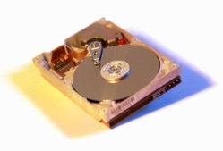
HANA 内存计算核心技术
200,000纳秒
0.5纳秒
7纳秒
15纳秒
100纳秒
SSD
10万倍的提升！
Core
CPU
L3
DRAM
CPU访问固态盘的时间
L1
L2
CPU访问硬盘的时间
CPU访问一级缓存的时间
CPU访问内存的时间
CPU访问二级缓存的时间
CPU访问三级缓存的时间
10,000,000纳秒
在新版本发布之前的18个月，HANA都会与芯片厂商一起，在CPU指令集和三级Cache做特殊的技术研发，确保充分发挥硬件资源，达到性能极致

Slide 6
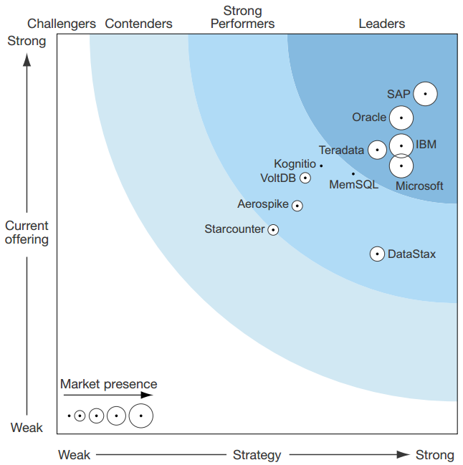
SAP HANA 居于内存数据库平台的领导者地位
Forrester Wave 评价报告：
SAP 的研发重点放在内存中技术得到了回报。SAP HANA 是全内存处理，面向列，关系型数据库管理系统 (RDBMS)，旨在支持交易和复杂查询处理的唯一数据集。SAP HANA自从 2011 年正式发布以来获得了 7000 多家客户。(见尾注 1)其市场投入宣传侧重于其多节点分布式架构和无共享内存计算平台、实时分析、 列式数据格式、 先进的压缩和数据服务层技术。今天，大多数企业使用 SAP HANA 作为内存处理的数据集市、 SAP 业务数据仓库、 SAP S/4HANA，SAP 商务套件。此外，与非 SAP 应用需求的应用程序开发开始加大。SAP 继续投资于工程技术和市场营销，特别着重于动态数据分层、 大数据、 数据安全、云、建模，并提高自动化水平。对于想要利用运行于云平台上的内存计算客户，SAP 提供 SAP HANA 云平台，开放的平台服务提供一个内存中的数据库和应用程序服务，用来建造、扩展或集成业务应用程序。HANA 也是可用在亚马逊网络服务 (AWS)，虽然 AWS 客户大多数都是小型和中型企业，但是 SAP HANA 提供了更为优秀的成本与性能的平衡。
超过甲骨文及IBM成为内存计算平台的领导者地位！

Slide 7


SAP HANA-内存计算 最简单的理解
1
数据总是直接写进内存
2
更新内存数据的同时写入日志
APPs, BI
3
数据定期写入磁盘并创建保存点
4
数据恢复时从磁盘读取保存点
I/O都在内存
5
数据恢复时从日志区读取记录
1
写入
内存（数据）
SAP HANA
硬件服务器
数据
来自任何DB
来自任何系统
2
4
3
5
同步写入
重 启
之 后
闪存-Flash（日志）
(日志卷) 1*RAM
异步
硬盘 (数据卷) 4*RAM

Slide 8

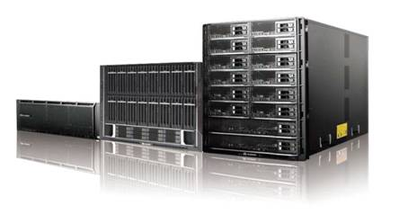
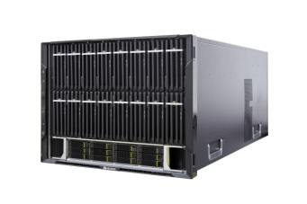
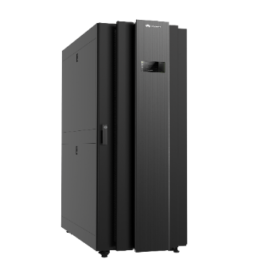
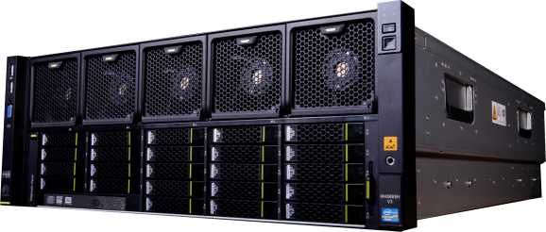
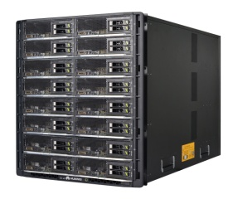
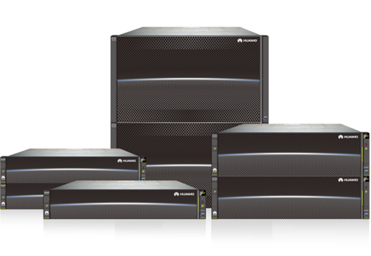
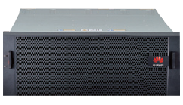
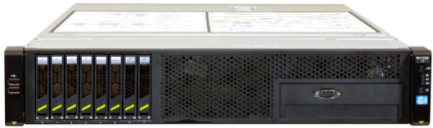
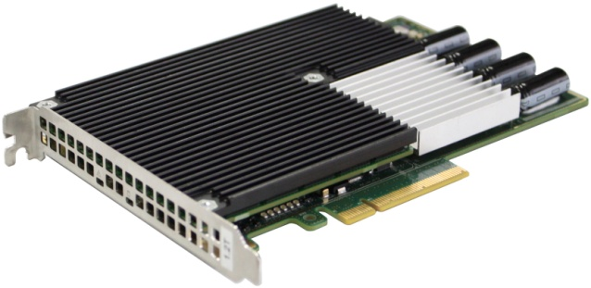

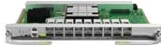
SAP HANA 硬件部署类型
Scale up
Scale out
Tailored Data Center
S/4HANA, SoH, Side-car, EDW
EDW, BW on HANA
Large Data Center on HANA
HP Converged System
RH8100 V3 (8P)
FusionServer
RH5885H V3 RH8100 V3
RH5885H V3 (4P)
IO Acceleration
OceanStor storage
FusionCube
融合架构
16P/32P server
传统架构
RH2288H V2 (2P)
OceanStor Storage
SSD Card
QDR/FDR Infiniband
FusionStorage

Slide 9





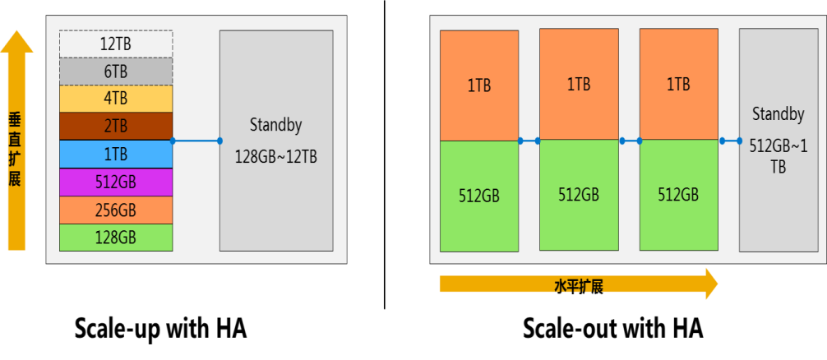






通用标准的硬件，支持灵活的扩展性 通过设备一体机的方式交付给客户
SAP HANA运行于标准的x86硬件之上，目前有13家供应商可提供HANA一体机
SAP HANA运行在标准的硬件模块上，硬件合作伙伴仅做少量的更改
SAP联合主流的硬件厂商提供HANA系统
最大支持12TB设备
最大支持100节点/2TB每节点
SAP HANA硬件的关键组件：
基于Intel Ivybridge E7 v2处理器，单台系统上可以配置2、4、或8颗CPU（即30、60、120核）
内存大小通常等于 128GB * CPU个数。在中等配置的设备上配置了4颗CPU以及1024GB内存
日志存储 - 通常用Fusion-IO ioDrive，容量和内存大小保持一致
磁盘存储 - 各厂家不尽相同，可以是本地SAS机械磁盘、或者网络存储

Slide 10

SAP HANA 内存计算架构
Supports any Device
Any Apps
Any App Server
SAP Business Suite and BW ABAP App Server
SQL
MDX
R
JSON
Open Connectivity
SAP HANA Platform
SQL, SQLScript, JavaScript
Spatial
Search
Text Mining
Stored Procedure & Data Models
Application & UI Services
Business Function Library
Predictive Analysis Library
Database Services
Planning Engine
Rules Engine
Integration Services
Transaction
Unstructured
Machine
HADOOP
Real-time
Locations
Other Apps
SAP HANA数据平台联合数据库、数据处理以及应用服务功能于一体，提供丰富的算法库包括预测、计划、文本、空间、地图等多种数学算法， 内置的商用分析引擎同时提供实时的报表服务。
Notes:
But how should we cope with all this data as a business, how can we integrate it into our core processes?
SAPs answer: we need a new platform for this, a platform that is much more than just another DB…

Slide 11


应用与平台 看事物的不同角度
平台到应用无缝衔接
业务价值点
客户应用
业务功能完整
最终用户体验
……
从应用到平台
应用与平台越来越紧密
应用离不开平台
应用逻辑下沉
应用持续使用
应用性能提升
平台离不开应用
数据存储方式
硬件环境配置
HA与灾备
从平台到应用
传统技术
数据安全保护
平台通用完整
……

Slide 12
SAP HANA关键技术原理

Slide 13

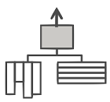



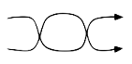

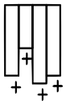
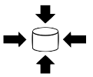
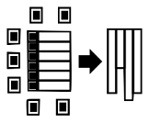
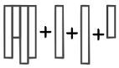
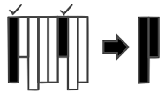
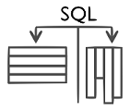
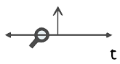

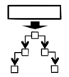

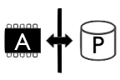
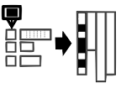
SAP HANA的关键核心技术
多核计算 / 并行化
动态多线程
虚拟聚合
架构层次缩减
表分区
MAP REDUCE
无磁盘操作
仅仅插入策略
轻量级压缩
任何属性作为索引
动态扩展表
最小化投影
+
T
CALL
3D
+
历史数据的直接分析
支持事务的列式表
SQL支持行式表与列式表
超出SQL的接口
空间数据支持
文本分析支持
统计、预测与业务分析库
冷热数据存储
对象关系映射
组键
单用户与多租户
实时复制
全球化研发, 始于2007年: 首尔，上海，胡志明市，班加罗尔，特拉维夫，柏林，瓦尔多夫，巴黎，多伦多，温哥华，都柏林，帕洛阿尔托
Notes:
This is a representation of many, but not all, of the main techniques pioneered by SAP HANA. Some are adaptations of previously know techniques such as Massively Parallel Processing and Column Stores, some, like the updatable column store were totally new innovations. However, where existing techniques were used typically HANA would take them a step further and, equally important, these techniques were combined in a particularly innovative manner. This took over six years of focussed R&D.
The development method itself was innovative, it was a distributed development project using top talent from around the world. When the developers in Europe went to sleep, those in Asia would wake up and continue, and when they reached the end of their day they’d hand over to developers in the USA and Canada. This went on for several years with hundreds of developers keeping development going literally around the clock. Other vendors typically took 10 elapsed years to do what we did, we did it in 3 by having a 24/7 continous ‘shift system’
HANA is known as an ‘in memory database’ but it is worth noting that of all the techniques only one of them mentions being in-memory – the “no disk” technique. This is a necessary part of the system but as you can see is by no means the full story.
Also the way in which we use the techniques can be different. Column Store databases had appeared before and shown their benefit and high efficiency by only transferring data in the subset of columns needed for a query and by allowing very efficient compression. However, HANA takes this further, it uses column stores not just for these traditional reasons but to ensure that by filling the column stores with binary encoded data (on the slide as “lightweight compression”) it can keep the Level 1,2 and 3 on chip caches filled and thus make full use of the SIMD and vector instructions available in modern CPU’s. This is how we get 3.2Bn scans / core / second and that in turn means we can dispense with aggregates and indexes.
HANA is a general purpose database, so another unique innovation is the ability to do transactional updates against the column store. As we mentioned, and as you can see here ,there is a lot more to HANA than simply putting our data in memory.
Modern workloads consist of more than just database work, there is also text processing, spatial, planning, OLAP, etc. etc. Therefore we have specialist engines for each of these that can collaborate within the in memory system, and we have an innovative language that allows us to process in all these different languages whilst keeping the procedures together, being processed in memory, in parallel.

Slide 14
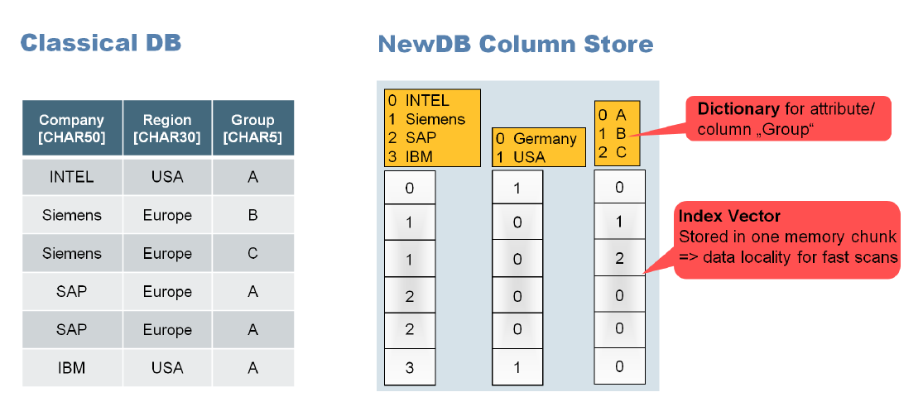
SAP HANA: 列存储
传统的数据库以行存储记录
列存储支持顺序内存访问
对不同的字段值进行字典编码，而表中的行只是指向编码索引的向量
结果：更快的数据访问（搜索），更好的压缩，快速聚集，更高效的连接操作
行存储
A | 10 | €
B | 35 | $
C | 2 | €
D | 40 | €
E | 12 | $
A | 10 | € | B | 35 | $ | C | 2 | € | D | 40 | € | E | 12 | $
映射到内存中
列存储
A | B | C | D | E | 10 | 35 | 2 | 40 | 12 | € | $ | € | € | $

Slide 15
列式与行式存储
SQL
数据库通常使用行式存储; SAP HANA 也支持行式存储, 但是它是为列式存储而优化的
Order | Country | Product | Sales
456 | France | corn | 1000
457 | Italy | wheat | 900
458 | Italy | corn | 600
459 | Spain | rice | 800
456 | France | corn | 1000
457 | Italy | wheat | 900
458 | Italy | corn | 600
459 | Spain | rice | 800
Row order organization
Single-record access:
SELECT * FROM SalesOrders
WHERE Order = ‘457’
456
457
458
459
France
Italy
Italy
Spain
corn
wheat
corn
rice
1000
900
600
800
Σ
Single-scan aggregation:
SELECT Country, SUM(sales) FROM SalesOrders WHERE Product=‘corn’ GROUP BY Country
Column order organization
Notes:
利用列式储存，表扫描（table scan）与数据预缓存(data pre-caching)可以被简化，因而性能可以得到极大的提升。

Slide 16
列式压缩 基于词典编码 (Dictionary Encoding)
对于每一列建立词典
使用基于数据决定的固定长度整型编码
直接操作压缩过后的整型数据，使用整型位操作而不是原始的字符串操作进行加速
这样计算将更多的利用CPU缓存中而不是内存
Compressed column (bit fields)
Inverted
index
Logical Table
Dictionary
Order | Country | Product | Sales
456 | France | corn | 1000
457 | Italy | wheat | 900
458 | Spain | rice | 600
459 | Italy | rice | 800
460 | Denmark | corn | 500
461 | Denmark | rice | 600
462 | Belgium | rice | 600
463 | Italy | rice | 1100
… | … | … | …
1 | Belgium
2 | Denmark
3 | France
4 | Italy
5 | Spain
1 | 3
2 | 4
3 | 5
4 | 4
5 | 2
6 | 2
7 | 1
8 | 4
… | …
1 | 7
2 | 5,6
3 | 1
4 | 2,4,8
5 | 3
Dictionary
5 entries, so need 3 bits to encode!
Which orders in Italy?
Where was order 460?
Notes:
词典编码 (Dictionary Encoding)
词典编码(Dictionary Encoding)的根据是数据本身包含有重复这个特性，其企图从输入的数据中创建一个“短语词典(dictionary of the phrases)”，编码数据过程中当遇到已经在词典中出现的“短语”时，编码器就输出这个词典中的短语的“索引号”，而不是短语本身。

Slide 17
列式压缩 基于行程编码(Run-Length Encoding)
压缩列式存储中的重复数据
在已经排序的稀疏数据中表现最好
SAP HANA还支持其它类型的压缩方式(前缀编码，聚类编码，稀疏编码等)
Logical Table
Country
Product
Order | Country | Product | Sales
456 | France | corn | 1000
457 | Italy | wheat | 900
458 | Spain | rice | 600
459 | Italy | rice | 800
460 | Denmark | corn | 500
461 | Denmark | rice | 600
462 | Belgium | rice | 600
463 | Italy | rice | 1100
… | … | … | …
1 | Belgium
2 | Denmark
3 | France
4 | Italy
5 | Spain
1 | corn
2 | wheat
3 | rice
3
4
5
4
2x2
1
4
…
1
2
2x3
1
3x3
…
Notes:
行程编码：Run-Length Encoding
仅存储一个值以及具有相同值的数目的数据压缩编码方式称为行程编码，或称游程编码，常用RLE（Run-Length Encoding）表示
时间因素，仅仅举两种压缩方法作为示例，SAP HANA中压缩方法还有很多，比如：
前缀编码: Prefix Encoding
聚类编码：Cluster Encoding
稀疏编码: Sparse Encoding

Slide 18
SAP HANA: 列存储的优势
高效的数据压缩
高效的压缩方法（run length，bit vector，dictionary 等）
压缩列，并且可以加速操作列
对每列进行高速的扫描速度
高压缩导致最佳的数据局部性=>内存中的高速扫描
每个属性都可以被用来作为一个索引（没有更新索引树的开销）
非常快整列扫描和连接join（每秒高达10亿个）
列上的快速聚集
聚集没有必要
实现简化的数据库架构
消除不一致的风险
更快的写入操作（无锁聚集）
简单的应用程序代码
Notes:
Because of compression, write changes into less compressed delta storage SAP HANA can provide ERP-specific data distribution: In many cases application data have the following redundancies:
Empty columns (up to 80%) and a lot of initial fields
Columns with few distinct values (e.g. currencies, indicators, product groups, ...)
Updates into delta data storage and periodically merged into main data storage
High write performance not affected by compression
Data is written to delta storage with less compression which is optimized for write access. This is merged into the main area of the column store later on.

Slide 19
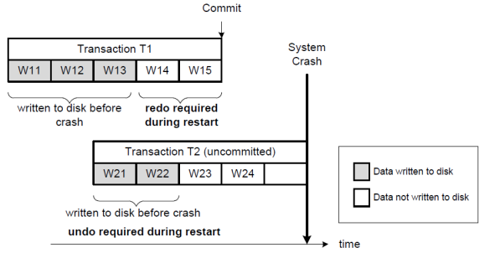
持久化存储
SAP HANA提供多种方式保证数据的持久化存储，以避免数据的丢失
常规的“保存点(savepoint)”
自上一“保存点(savepoint)”的所有数据库事务日志
“快照(Snapshot)”，用于数据库备份
Redo & Undo Log
Notes:
同样也有人会质疑内存储存的数据是否会存在丢失的状况，SAP HANA的持久化储存机制保证了无论在任何状况下（掉电、系统崩溃等），数据都不会丢失。
Savepoint是每隔一段时间进行的，其间隔可以调整。保存点之间的数据事务靠Log进行持久化，为了保证速度，Log需要存储入SSD固态硬盘。
右图表示了对于已经提交和未提交的事务，分别使用redo和undo log来保证数据即便在系统崩溃时，也不至于丢失。

Slide 20
计算并行化
SAP HANA充分利用多路多核CPU资源，对于下列情形尽可能并行处理
并发用户或连接
不同数据分区并行处理，不论在独立实例或者集群环境
单一查询或者储存过程中表的水平或者垂直划分，每部分并行处理
SAP HANA的并行化处理对于应用开发者是完全透明的，其无需关心内部实现细节
quant.
150
60
100
45
75
84
96
162
45
366
type
43
12
12
33
33
12
32
43
12
33
sales
$1000
$900
$600
$800
$500
$750
$600
$600
$1100
$450
$2000
core3
core4
core1
core2
Notes:
SAP HANA紧跟当前的硬件发展形势，特别是CPU的多路多核化趋势，充分并行化的进行计算处理，以此提高计算资源的利用率。
只讲了一半,后续会讲Data Federation

Slide 21

基于列式表的“Insert-Only”策略
+
+
+
+
SAP HANA的列式表的储存空间分为Main Storage (针对读优化) & Delta Storage(针对写优化)
使用“Insert-Only”的策略在“Delta Storage”中记录增加与修改
“Delta Storage”中的插入/更新记录按照时间排序
此种设计减少了锁冲突
需要偶然的“Delta Merge”
Main Storage
456
457
458
459
France
Italy
Italy
Spain
corn
wheat
corn
rice
1000
900
600
800
456
457
458
459
460
France
Italy
Italy
Spain
Denmark
corn
corn
corn
rice
corn
1000
900
600
800
600
Delta Storage
update
457 | Italy | corn | 900
delta merge
insert
460 | Denmark | corn | 600
Notes:
有人会质疑列式表的修改性能不佳，应该差于行式表，这不是事实。因为SAP HANA使用”Insert-Only”来解决这一问题。

Slide 22
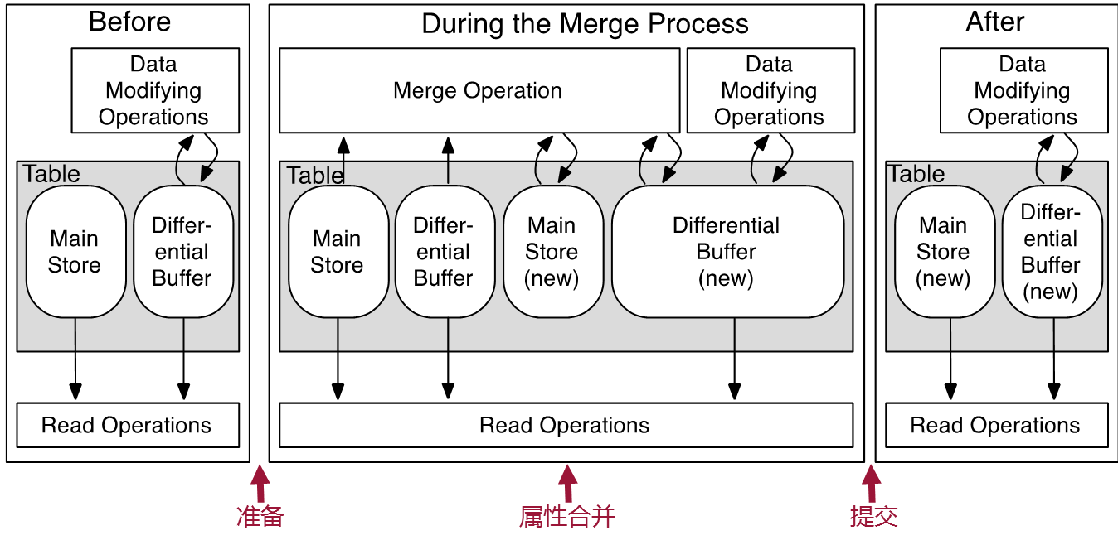
Table Storage: Main storage, Delta storage (Insert-only on delta)
Main Storage: Data structure containing the main part of the data.
• Problem: Direct write operations would need to reorganize column storage structure and recalculate the compression.
• Solution: Write operations do not directly modify compressed data. Changes(Insert-only on delta) are written into a structure called Delta storage, only available in main memory, with basic compression optimized for write. Only Delta logs are written in the Persistence Layer.
• For each non temporary persisted table there is one delta log virtual file
• Changes are taken from delta storage asynchronously (Delta Merge)

Slide 23
SAP HANA: 多版本控制机制(MVCC)
并发控制机制的一个重要需求是尽量减少对性能的影响。
并发的读操作在不阻塞并发写操作的情况下看到一个一致性的数据库视图。
更新操作不覆盖现有的记录，而是通过插入新的版本来实现。所以一个事务可以写入某个数据项一个新版本，同时其他并发事务可以读取这个数据项的以前版本。
删除操作也可以通过插入新的版本来实现，同时采用某种机制来表示以前的版本不再被后续的交易可见。
数据库隔离级别
事务级别的快照隔离
→对应SQLServer“可重复读”隔离级别。
语句级别的快照隔离
→对应SQLServer“已提交读”隔离级别。
历史表
使SAP应用程序可以执行“时间旅行查询”，得到过去任何一个时间点的一致性视图，如业务数据的审计

Slide 24
MVCC: Multi Version Concurrency Control
T1
update personal
set name = ‘Jones'
where userid = '4711'and name = 'McEwen'
commit
MVCC transaction level Snapshot
select *
from personal
where name like 'M%'
select *
from personal
where name like 'M%'
T2
PNR NAME
PNR NAME
Version n
4711 McEwen
5200 Miller
4711 McEwen
5200 Miller
MVCC statement level Snapshot
select *
from personal
where name like 'M%'
select *
from personal
where name like 'M%'
PNR NAME
T3
4711 McEwen
5200 Miller
PNR NAME
5200 Miller
© SAP AG 2011
Notes:
Multi version concurrency control ensures consistent read operations.
An in-memory computing transaction starts either as read or a write transaction. A transaction starts as read transaction but can be promoted into a write transaction by the transaction manager. Concept of MVCC:
updates do not overwrite existing records updates insert new versions => transactions may write a new version of some data while concurrent transactions still have read access to previous versions.
Transaction level snapshot: all statements of a transaction see the same snapshot => isolation level repeatable read
Statement level snapshot: different statements in a transaction may see different snapshots => isolation level read committed (non repeatable read) Each statement sees the changes that were committed when the execution of the statement started.
Statement level snapshot is the default Isolation level (Read Committed).
Using timestamps allows to determine which versions are visible for which transactions.

Slide 25
SAP HANA 数据中心具备的能力
SAP HANA
数据中心能力
备份和恢复
数据和日志备份
时间点恢复
第三方备份工具支持
Netbackup, Tivoli, Simpana, DataProtector, Networker, Sesam…
存储镜像
时间点恢复
高可用性
硬件故障或系统宕机时同数据中心的备份系统自动接管
接管类型：
存储接管
镜像数据库接管
内部或外部的集群管理
灾难恢复
接管到远程数据中心的HANA数据库
自动或手工处理接管过程
接管类型：
存储接管
镜像数据库接管
外部集群管理
设计和配置
多种部署选择
多租户数据库容器
一个HANA数据库上的多实例
生产系统的虚拟化部署
定制化的数据中心集成方案
动态分层存储
安全和审计
完整的安全框架
用户授权
数据传输加密
兼容安全协议 (SoD, audit logging, ...)
安全的硬件及软件设置
用户管理IDM及合规管理GRC集成
支持第三方安全软件标准接口
持续提升使系统更简化及更灵活

Slide 26
备份原理 Memory ➔ Disk ➔ Backup
SAP HANA database
Data backups
Contain the current payload of the data volumes
Any pages that are changed during the data backup written to different locations in the data volumes (shadow page concept)
Manual (SAP HANA studio, SQL commands), or scheduled (DBA Cockpit)
Log backups
Contain the content of closed log segments
Automatic (asynchronous) whenever a log segment is full or the timeout for log backup has elapsed
Memory
Savepoint
COMMIT
Data Area (disk)
Log Area (disk)
Data Backups
Log Backups

Slide 27
恢复方式
Full Backup
Delta Backups
Time
Data recovery
Log replay
Restart
A recovery typically consists of the following phases:
Data recovery (full backup + delta backups, if applicable)
Log replay (log backups + log entries from the log area, if applicable)
Restart

Slide 28
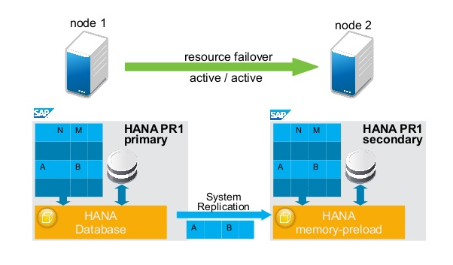
单节点高可用性 HANA System Replication + Suse or RedHat Automate HA
The HANA System Replication is NOT designed to enable or disable HANA Primary and Secondary Database automatically. The HANA database administrator should be monitoring and perform takeover commands in order to bring secondary system UP when required or decided.
Customers should be combine HANA System Replication and RedHat Cluster or Suse Cluster in order to provide automate failover to HANA servers.
Sample below:
HANA Disk
Disk Mirror
active/active
HANA Disk

Slide 29


SAP HANA Active/Active Read-Enabled
Read, Write, Update and Delete Operations on Primary HANA Platform
Read Operations Only on Secondary HANA Platform
Users / Applications
Continuous Data Replication via Synchronous or Asynchronous Telecommunications
Primary Data Center
Secondary Data Center
Data Is Continuously Replicated from the Primary to the Secondary Using either Synchronous or Asynchronous Communication Protocols | Customers can leverage secondary system to offset read-intensive workloads from primary system | Gain usage rights to access secondary system for productive read-enabled operation Increase HW utilization Improve performance on primary

Slide 30
多节点集群高可用性 HANA System Replication + Scale-Out with Host Auto-Failover
Server 1
Scale-out clusters address two problems
Scale to a setups, bigger than one host
Offer an easy HA option by putting one or more hosts as spare/standby
Host Auto-Failover is offered by the Name Service
The resulting cluster is managed by this name service inside of HANA.
He regularly checks on the cluster members to be still active.
In case of problems he initiates a fully automated take-over to the standby hardware.
Together with the switched of mounts/disks also the identity of the failing cluster member is moved to the standby hardware.
Starting with shared storage, HANA Scale-Out today can use SAN storage with FibreChannel adapters
Storage Connector API ensures the possibility of remounting necessary file systems to standby hosts
More details with: SAP Note 1900823 - Storage Connector API ⇨ Please check its attachments for white papers etc.
Name server
Name server
Server 2
Name server
Server 3
Shared Storage
Name server
SAN Storage
Server 4
Storage Connector API
Name server
Server 5
Name server
Server 6
Name server
Standby Server
Minimalistic setup for only HA:
Name server
Server 1
SAN Storage
Storage Connector API
Name server
Standby Server
Notes:
(https://service.sap.com/sap/support/notes/1900823)

Slide 31


数据中心容灾设计
Clients
Application Servers
本地数据中心
异地数据中心
Data Center
HA Solution Partner
HA Solution Partner
OS: DNS, virt. hostnames, virt. IPs
Primary (active)
Secondary (active, data pre-loaded)
异步
Name Server
同步
Transfer by HANA database kernel
Name Server
Index server
Index server
Internal Disks
Internal Disks
容灾中心部署
Data Disks
Log Disks
Data Disks
Log Disks
容灾系统设计
鉴于大数据平台为中国邮政的核心业务平台，建议采用两级容灾机制
本地/同城灾备中心：同步数据复制
异地灾备中心：可选择基础情况较好的省中心，异步数据复制
异地灾备中心冗余的资源也可以用于开发/测试
快速的RTO (最小化RTO)
同步复制－零数据丢失
数据库容灾技术
数据库容灾 (System Replication) – 已集成于HANA内部
基于HANA的日志复制技术
日志通过网络传输
可支持同步/异步数据复制
灾备中心可选择内存同步复制方式（灾备中心数据在内存中预装载）
能够保持事务的一致性：进行中的事务被回滚并被重演，无数据丢失
备注：SAP HANA 2.0企业版支持双活数据中心(Active-Active)的部署方式，灾备中心的HANA数据库可以只读的方式打开进行数据查询操作，这样可以承担更多的主数据中心负载，提高设备及投资的利用率。

Slide 32
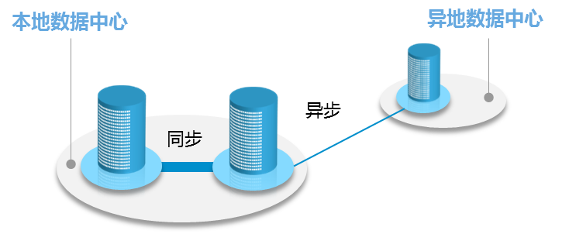
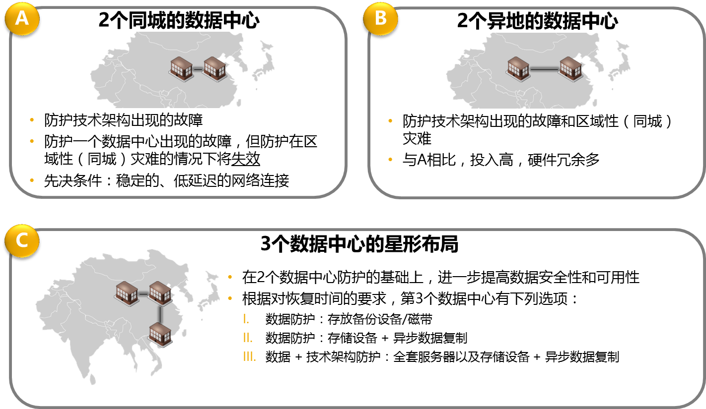
























容灾的方式和选择
数据和技术架构保护
• 主数据中心内或同城数据数据中心间，HANA系统同步复制数据
→ 故障切换时间很短，可实现自动故障切换
• 异地数据中心间，HANA系统数据异步复制
→ 发生灾难情况下，系统可在较短时间内恢复，一般由手工控制切换
数据 中心1
SAP HANA
SAP
数据 中心2
SAP HANA
HANA
同步复制
异步复制
关于SAP HANA容灾技术
在HANA容灾目前支持两地三中心系统配置，核心技术为系统复制组件，可实现同步复制和异步复制方式，此技术集成于HANA数据库中，无需第三方软件支持
数据 中心1
数据 中心2
数据中心3
SAP HANA
SAP HANA
SAP HANA
同步复制
异步复制

Slide 33
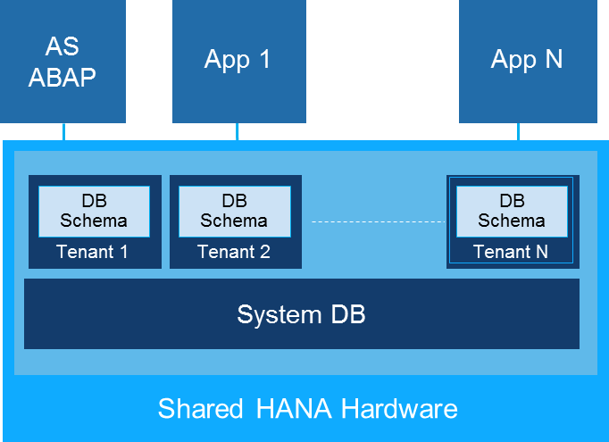
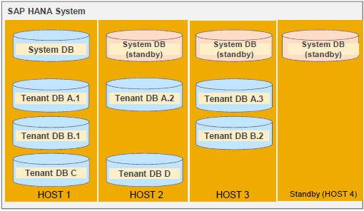
MDC（多租户数据库技术）
通过MDC的配置方式，实现HANA数据库物理上合并，逻辑上独立，可以方便快捷的将多应用迁移到HANA平台，并有以下好处:
灵活的系统架构
按需分配的云管理模式
系统迁移及变更(可通过系统复制，备份/恢复快速实现)
租户数据库级别独立
资源管理及分配
用户与数据完全隔离
独立的管理及监控
优化的跨数据库读取操作
减少总体成本TCO
最大化使用硬件计算资源
集中统一的管理及监控
统一的高可用及灾备解决方案

Slide 34
SAP HANA应用功能组件

Slide 35
SAP HANA全方位的数据服务及创新平台 整合多元数据源，统一企业数据模型规范，为业务应用提供统一的数据服务
所有设备
SAP应用、第三方应用和企业开发应用
一体化数据应用平台
应用服务
数据处理服务
集成和质量服务
</>
Web 服务器
Java脚本
空间
Graph*
预测性
查询
数据展示
ETL及复制
ALM
Fiori
用户体验
图像建模器
应用
生命周期管理
文本分析
流数据分析
Series 数据
业务功能
数据质量
Hadoop & Spark 集成
远程数据同步
数据库服务
多栏式 OLTP+OLAP
多核心及并行
高级压缩
多租户
多层存储
数据模型
开发
行政与安全
高可用性及灾备
单一开放平台
多数据格式
唯一数据
敏捷 Speed
简约 Simplicity
创新 Innovation
无延时的数据访问及处理
在单一平台上处理多元化数据格式
在单一平台上维护唯一的数据副本

Slide 36

数据处理平台功能-数据存储优化
SAP HANA内存计算
内存数据处理提供实时数据结果
联合结构化和非结构化数据
新的行业解决方案和业务应用
基于预测、文本、空间计算的分析方法
SAP HANA动态分层
准实时处理和分析功能
高性能企业数据仓库的辅助
Dynamic near line storage动态的近线存储
Hadoop/SPARK
低成本的数据探索在廉价的硬件之上
从大量的非结构化数据中获取数据（支持MapReduce程序的数据同步）
Hadoop分布式文件系统（HDFS）提供无限数据存储
SAP HANA 数据管理平台
数据管理 | 文本 | 查询 | 图形 | 空间处理 | 预测
SAP HANA 内存计算
SAP HANA 动态分层
∞
HADOOP/SPARK
HANA VORA
0.1秒
无限存储 元数据
实时计算
温数据
智能数据流处理
管理 | 监控 | 操作 | 用户 | 安全

Slide 37
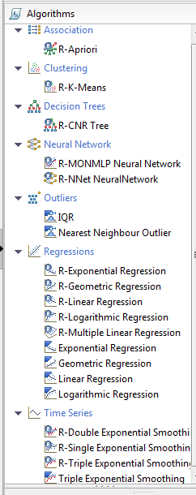
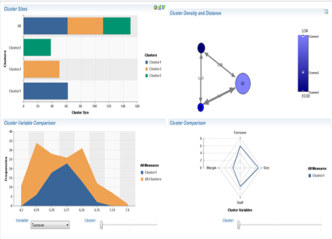
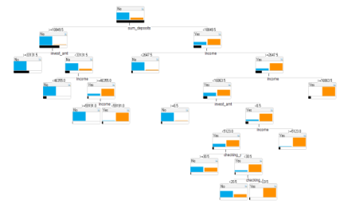
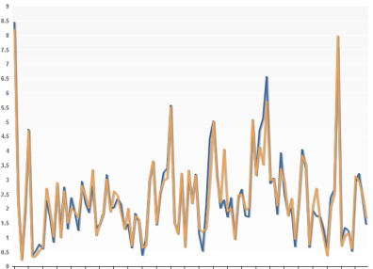
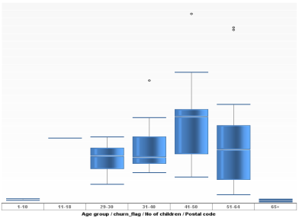
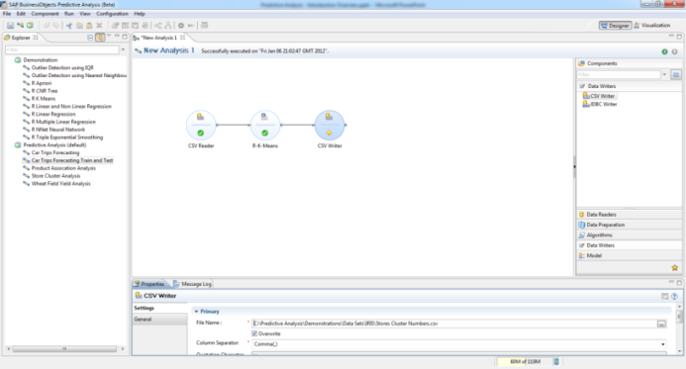
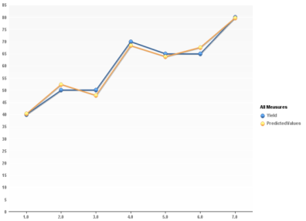
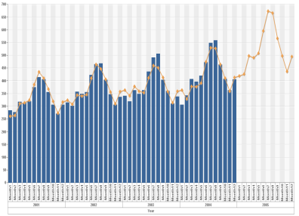
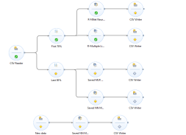
数据挖掘和预测：可视化应用，丰富的预置预测模型
挖掘算法支持：
SAP HANA内置的Predictive Analysis Library (PAL)算法包
SAP HANA提供流程图式数据建模 – Application Function Modeler工具
R算法服务器与HANA服务器集成
平台优势：
自动数据准备和探索、完整的数据挖掘过程、强大的预测算法库
直观地设计复杂的预测模型，可视化分析
丰富的建模技术，可扩展的预测模型：
关联分析
聚类分析
决策树分析
神经网络分析
例外分析
回归分析
时间序列分析
概率分布
…
聚类分析
决策树分析
神经网络分析
例外分析
多元回归分析
时间序列分析

Slide 38
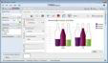




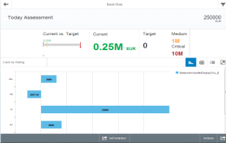
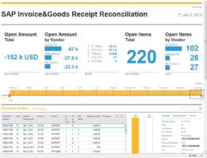
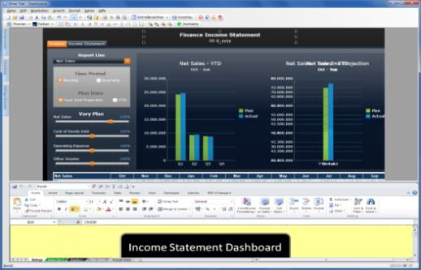
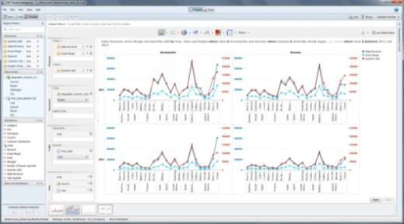


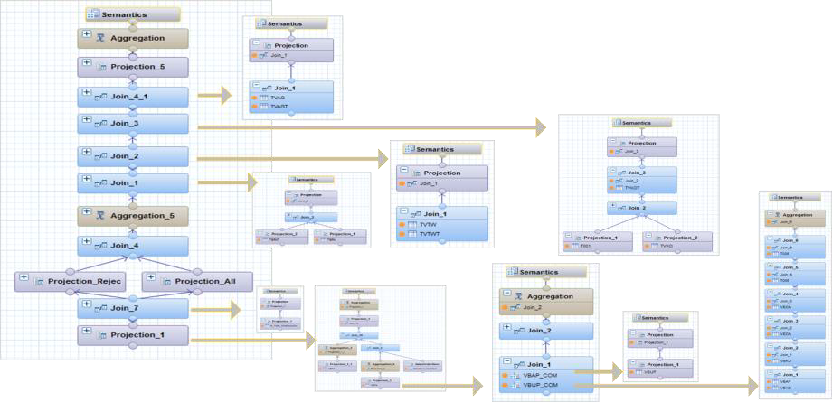
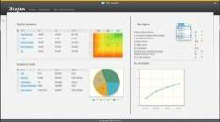


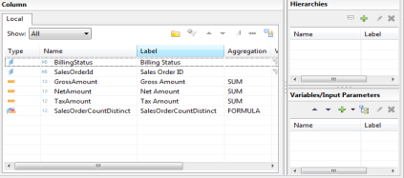


















SAP HANA 数据建模的虚拟化概念
Virtual Data Flow Models
Operational Reporting | Applications | Analytics
SAP HANA PLATFORM
HANA Views
•No persistent Aggregations | single atomic copy of data
•In-Memory Engines | Performance
Physical Tables
Database Layer
•Multidimensional Reporting Models
•Enterprise Applications Virtual Data Models
©2017 SAP SE or an SAP affiliate company. All rights reserved.

Slide 39




SAP HANA Remote Data Sync – 远程数据复制
功能
场景和用例
•同步*数据于HANA和众多远程数据库之间
•获得 数据并分析介于中速网络与低速网络之间
优势
•物联网 –在HANA与大量的设备网关之间建立双通道的数据交换机制
•设备离线 –为各种应用提供复杂的使用环境支持
•远程数据源与系统应用之间保持持续的数据连接
•丰富的边缘计算能力为物联网项目提供支持
•卫星服务 –远程工作场所的连续操作
远程场所 总部
同步服务器 SAP HANA 商务套件
✓
应用
数据同步
远程场所
远程场所
远程场所
报表和附件
HANA 数据中心
文件系统
*Synchronization:two-way, session-based, configurable, data replication, often over public networks.
©2017 SAP SE or an SAP affiliate company. All rights reserved.

Slide 40

SAP HANA Smart Data Integration – 智能数据集成
数据复制
概览
•基于浏览器的复制编辑器
•同时可选择一个或多个对象
•提供实时数据复制功能
配置设定
•目标列
–按需定制目标表
•过滤
–可限制复制的条件
•复制动作
–改变默认的复制动作
o 在应用中判断发生变化的记录，例如SAP BW, SAP Data Services等
o对于时间相关的报表，可设定历史变化记录
–缩短数据初始装载的时间
©2017 SAP SE or an SAP affiliate company. All rights reserved. 104

Slide 41



SAP HANA Smart Data Integration – 智能数据集成
批量数据加载
概览
•HANA 工作台或HANA 网页版开发台
•设计简单或复杂的工作流
数据转换
•基于SQL
–Aggregation, Filter, Join, Sort and Union
•高级SQL
–Case, Lookup, Pivot and Unpivot
•数据生命周期
–Date Generation, History Preserving Map
Operation, Row Generation and Table
Comparison
•数据质量
–Cleanse, Match and Geocode
•代码执行
–AFL, Procedure and R Script
©2017 SAP SE or an SAP affiliate company. All rights reserved. 105

Slide 42


SAP HANA Smart Data Integration – 智能数据集成
实时数据合并
概览
•HANA 工作台或HANA 网页版开发台
•设计简单或复杂的工作流
•提供选项方式设置实时数据合并
Leverage an existing batch
scenario and just check
the “Real-time” option
数据转换
•基本SQL
–Aggregation, Filter, Sort and Union
•高级SQL
–Case, Lookup
•数据生命周期
–Date Generation, History Preserving Map
Operation, Row Generation and Table
Comparison
•数据质量
–Cleanse, Match and Geocode
©2017 SAP SE or an SAP affiliate company. All rights reserved. 106

Slide 43





SAP HANA Smart Data Streaming (SDS) – 智能数据流
从实时数据流中获得信息并进行即刻的反馈
SAP HANA 智能数据流
SAP HANA平台可扩展实时事件流式处理功能
可从设备和应用端连续的抓取数据
新数据获取的同一时刻立即采取行动：预警，通知或立即改变数据处理条件
提供可视化的操作仪表台监视数据
高度可扩展性 – 在秒级的周期内处理成千上万的数据以及设备上的事件信息
Applications
Stream
(push)
connect,
query
Incoming Streams
SAP HANA Platform
Streaming
Lite
Devices / IoT
Gateway
Streaming
Service
SAP HANA Platform with smart
data streaming
•Internet of Things: collect and monitor data from smart devices; immediately respond to new opportunities or
imminent problems.
©2017 SAP SE or an SAP affiliate company. All rights reserved.

Slide 44


SAP HANA Smart Data Quality – 智能数据质量
SAP HANA平台可扩展内嵌的数据质量功能
数据清洗 – 解析，标准化，校验和修正人员及地址信息
匹配 – 跨单个或多个数据源，查找重复数据记录
定位 – 丰富的地理经度和纬度的地址数据
通过内存计算能力增强数据质量处理性能
•通过内存引擎提升数据处理能力
简化用户接口
•通过简单方法和工具清洗数据
©2017 SAP SE or an SAP affiliate company. All rights reserved. 111

Slide 45











SAP HANA Smart Data Access – 智能数据访问
本地及混合环境下的数据虚拟化
优势
允许像本地表一样的方式访问远程数据
智能的查询处理包括查询分拆，计算下沉，功能互补等
支持数据存储地算法开发
方便的访问异构数据源
Transactions + Analytics
SAP HANA
^{HANA Tables} Virtual Tables
支持的异构数据源
•Oracle, MS SQL, Teradata
•Hadoop–Hive (Intel, Hortonworks,
etc.)
Teradata
Oracle
•SAP Sybase ASE and IQ
•SAP Sybase ESP, SQLA
ASE/IQ
Hadoop
SAP HANA
©2017 SAP SE or an SAP affiliate company. All rights reserved. 107

Slide 46
HANA相关问题说明

Slide 47
使用SAP HANA内存数据库的相关问题
HANA内存数据库的列存储、行存储的原理；
HANA内存数据库的列存储相比于ORACLE12c的IN-MEMORY列存储的优势；
HANA内存数据库的行存储相比于ORACLE12c的TIMESTEN行存储的优势；
HANA内存数据库的高可用性架构；
HANA内存数据库的灾备架构；
HANA内存数据库的高可用、灾备对应用透明该如何实现？是否需要借助中间件；
HANA内存数据库同步数据的原理（传输数据块还是日志文件等）、应用日志的原理（直接修改数据库还是SQL重做等）；
HANA内存数据库的横向扩展能力；
HANA内存数据库的仲裁机制、仲裁原理；
HANA内存数据库在服务器宕机重启后重新加载数据的耗时，在最短时间内加载完大量数据的最佳实践方案；
HANA数据库的导数方案（包括数据文件的导入到HANA数据表，以及HANA数据表导出成文本文件的效率）；
备份还原方案；

Slide 48
1. HANA内存数据库的列存储、行存储的原理
行数据布局
列数据布局
数据以数组为单位储存
充分利用单一数组的属性共置
重建成本低，但单一属性的顺序扫描成本较高
数据按属性进行储存
充分利用主内存中的顺序扫描速度
数组重建非常昂贵

Slide 49
2. HANA内存数据库的列存储相比于ORACLE12c的IN-MEMORY列存储的优势
Insert-only仅插入机制，同时兼顾写优化和读优化
MVCC （Multi Version Concurrency Control）多版本控制机制，消除高并发时的锁发生
Delta Merge增量合并机制，重组数据布局更新压缩算法，双区域操作不影响更新和查询
混合压缩算法，提升数据存储效率，提高顺序扫描速度
列存储上的并行算法引擎，智能拆分计算单元

Slide 50
3. HANA内存数据库的行存储相比于ORACLE12c的TIMESTEN行存储的优势
全内存化的行存储处理，行存储数据在启动时自动全量加载入内存
MVCC （Multi Version Concurrency Control）多版本控制机制，消除高并发时的锁发生
行存储表与列存储表支持交叉查询操作
Timesten是Oracle主库的高速缓存库（cached db），无法独立存储和处理数据
Timesten主库建议40GB大小，单表容量不超过1000万条记录
Timesten本身不支持集群，多节点完全靠Oracle RAC实现

Slide 51


4. HANA内存数据库的高可用性架构
单节点高可用性
多节点高可用性

Slide 52
5. HANA内存数据库的灾备架构
数据和技术架构保护
• 主数据中心内或同城数据数据中心间，HANA系统同步复制数据
→ 故障切换时间很短，可实现自动故障切换
• 异地数据中心间，HANA系统数据异步复制
→ 发生灾难情况下，系统可在较短时间内恢复，一般由手工控制切换
数据 中心1
SAP HANA
SAP
数据 中心2
SAP HANA
HANA
同步复制
异步复制
关于SAP HANA容灾技术
在HANA容灾目前支持两地三中心系统配置，核心技术为系统复制组件，可实现同步复制和异步复制方式，此技术集成于HANA数据库中，无需第三方软件支持
数据 中心1
数据 中心2
数据中心3
SAP HANA
SAP HANA
SAP HANA
同步复制
异步复制

Slide 53

6. HANA内存数据库的高可用、灾备对应用透明该如何实现？是否需要借助中间件

Slide 54
7. HANA内存数据库同步数据的原理（传输数据块还是日志文件等）、应用日志的原理（直接修改数据库还是SQL重做等）
SAP HANA Storage Replication of SAP HANA disk areas controlled by storage technology
First synchronous implementation (available, SAP note 1755396)
Afterwards asynchronous implementation planned and in preparation with HW partners
SAP HANA System Replication: DATA content is only initially transferred to secondary site, afterwards continuous LOG transfer and LOG replay on secondary site
LOG is provided to secondary site on transactional basis (COMMIT) controlled by SAP HANA database (including initial DATA transfer)
Fastest switch-over times, sec. site preloaded and rolled forward on COMMIT basis
Synchronous and asynchronous implementation planned for next steps
Redo Log is processed immediately on Secondary (Commit based)
No more delta-data transfer necessary
Reduced take-over times
Network traffic significantly reduced
Automatic initial data transfer still supported
Operations mode delta data shipment still supported
Compatible to the current set of operation commands – optimization under the hood
Parameter name operation_mode [delta_datashipping|logreplay]
Multi-Tier system replication supported
No mixture with delta-data shipment (all members must use same operation mode)
Build the foundation for active/active oper`ations
Automatic Initial Data Load
Primary
Delta- Data
Secondary
HANA
HANA
Log
Log replication modes | Since | Short name in system table SR_REGISTER
Synchronous | SPS 05 | SYNC
Synchronous in Memory | SPS 05 | SYNCMEM
Asynchronous | SPS 06 | ASYNC
“Full SYNC option” | SPS 08 | SYNC

Slide 55




8. HANA内存数据库的横向扩展能力
数据仓库平台 分析型数据应用
大规模并行处理
数据均匀分布在各个节点（数据分区），并行处理
提供更高的处理性能与并发性
良好的线性扩展性
支持大规模的集群部署，（可支持上百个节点）
可基于数据分布优化器（DDO）优化数据分布
高可用集群架构
集群中可配置备用节点，可接管故障的工作节点
热备节点数量=容错节点数
自动的故障切换与数据装载
生产节点
生产节点
生产节点
热备节点
Master
Master2
SAP HANA DB
In-memory computing
DB分区1
DB分区2
DB分区N
DB分区N
HANA DB
Worker节点
HANA DB
Worker节点
HANA DB
Worker节点
HANA DB
Standby节点
索引服务器
统计信息服务器
索引服务器
统计信息服务器
索引服务器
统计信息服务器
索引服务器
统计信息服务器
共享卷
SAS存储1
SAS存储2
SAS存储N
日志卷
日志卷
日志卷
数据卷
数据卷
数据卷

Slide 56
9. HANA内存数据库的仲裁机制、仲裁原理；
HANA是MPP架构的share-nothing数据库，无需仲裁节点
HANA集群是整体执行的数据库系统，不会拆分成几个独立运行的单体数据库或子集群（即所谓的脑裂现象）

Slide 57

10. HANA内存数据库在服务器宕机重启后重新加载数据的耗时，在最短时间内加载完大量数据的最佳实践方案
Open Persistence files (Data Volume, Log Volume)
This and following steps are executed per HANA service individually
Converter is loaded from the last successful Savepoint
Load RowStore
Execution time depends a lot on size. Creation of secondary indexes happens decoupled after Restart (after 5.)
For HANA persistence RowStore is similar to a BLOB and finally opened logically on engine level
Initialize Hybrid LOBs (can be millions especially with SoH)
LOBs bigger than 1 Kbyte are usually extracted to HANA data volumes and organized via pointers as soon as this database was created since SPS07. Every ABAP text data type “string” is translated into a LOB on the database level. This produces effort to initialize this huge number of small LOBs during startup. With native applications you could try of utilize more data types next to LOB-like structures (varchar).
Get open transactions to follow up on (Data Volumes)
Rollback information is located on Data Volumes, not Log Volumes (allows a consistent database recovery only with the help of a HANA data backup)
Roll forward information (redo-log) is located on the online Log Volume
Roll forward Log for Row and Columnar store
First loads of columnar structures are executed as they are accessed to actually roll forward the log on them
Next to roll forward also roll back operations can happen in this step if open transactions could not be finished before the database stopped. This is usually very fast, but in rare occasions we saw long running executions depending on the nature of these unfinished transactions.
At the end of this redo-log operation the database is technically available – log-on possible
Start loading columns marked with the preload flag
Allows to load columns used by important business processes before the next step, if they are not already loaded by the roll-forward in the step before
Start loading tables from the list of lately used tables
During the normal operation before the restart HANA tracks a list of tables which are currently loaded (once per day)
This list is now the basis of loading the necessary tables into main memory
Possible optimization 1:
RowStore size reduction – check following slide
Possible optimization 2:
Better thresholds for the size of LOBs moved into Hybrid LOB structures
Possible optimization 3:
Fast IO System - especially important for the steps 2., 6. and 7., but also good for the other steps

Slide 58
11. HANA数据库的导数方案（包括数据文件的导入到HANA数据表，以及HANA数据表导出成文本文件的效率）
数据导入：
DI/SDI
SLT/SRS
File import
ESP/SDS/MQ/Kafka/…
数据导出：
DI/SDI
File export

Slide 59
12. 备份还原方案
文件系统备份 利用DAS存储数据的备份集
第三方工具备份 HANA的Backint可兼容主流的备份软件
存储快照备份
将存储设备的数据快照作为备份集
HANA的备份方式
文件系统备份
第三方工具备份
存储快照备份
备份建议
1. 直接采购第三方 for SAP HANA的备份接口许可，可直接备份到第三方管理的备份集，并且第三方提供智能恢复功能
2. 文件系统与第三方备份结合，先由HANA生成备份卷到文件系统，再由第三方以文件方式备份，但是之后的备份管理和恢复管理需要由人工完成
SAP HANA studio
SAP HANA studio
SAP HANA studio
Storage Tool
hdbsql
hdbsql
hdbsql
Create backup
Create backup
Prepare database
Confirm storage snapshot
SAP HANA Database
Backup Storage, e.g. NFS
SAP HANA Database
SAP HANA Database
External Storage
Data Area (Disk)
Create storage snapshot
3rd Party Backup Server
Data snapshot
3rd Party Backup Agent
利用数据内置的备份功能，低成本的备份与恢复方案
仅需HANA服务器连接存储设备（如NAS）
最便捷管理数据备份的方式
SAP HANA has full control about B&R management
可快速地创建数据备份集
可与其它备份方式结合使用，提升系统可恢复性
首选的备份方式

Slide 60
SAP HANA Backup and Recovery Backint-certified tools as of 2016.11.
Certification is an installation prerequisite for tools using the “Backint for SAP HANA” API
See SAP Note 1730932 (Using backup tools with Backint)
Online listing of certified tools: Application Development Partner Directory
Enter the search term HANA-BRINT and click on a partner name → ”SAP Certified Solutions” for further details
Vendor | Backup tool | Intel Arch. | POWER Arch. BE HANA 1.0 | POWER Arch. LE HANA 2.0 | Support process (SAP Notes)
Allen Systems | ASG-Time Navigator 4.4 | ✓ |  |  | 2212571
Commvault | Simpana 10.0; Hitachi Data Protection Suite 10.0 | ✓ ✓ |  |  | 1957450, 2345177
 | Commvault 11.0; Hitachi Data Protection Suite 11.0 |  | ✓ ✓
EMC | NetWorker 8.2; Interface for Data Domain Boost 1.0 | ✓ ✓ |  |  | 1999166, 1970559
HP | Data Protector 7.0, 8.1, 9.0; StoreOnce Plug-in for SAP HANA 1.0 | ✓ ✓ |  |  | 1970558
IBM | Tivoli Storage Manager for Enterprise 6.4 | ✓ |  |  | 1913500
 | Spectrum Protect for Enterprise Resource Planning 7.1 |  | ✓
Libelle | BusinessShadow 6.0.6 | ✓ |  |  | 2212575
Mindtree | NBU CONNECTOR for SAP HANA 1.0 |  | ✓ |  | 2330945
SEP | SEP Sesam 4.4 | ✓ | ✓ |  | 2024234
Veritas (Symantec) | NetBackup 7.7 | ✓ |  |  | 1913568
New
New
New
Notes:
New: A new certification for the HANA on POWER Little Endian architecture

Slide 61

谢谢！
关注SAP中国，随时随地与我们互动
官方微博 (新浪)
@SAP中国 @SAP天天事
官方微信：SAP天天事 (二维码见右)

Slide 62
应用
列式
存储
行式存储
业务管理器
永久层
永久层
-磁盘
写操作
写入增量
虚拟文件
在内存中
执行操作
写入redo及undo日志
写操作
在内存中
执行操作
写日志
提交
写入提交
日志项目
磁盘内永久日志
表T的增量合并操作
写入虚拟主文件，缩短增量记录
在页面缓存写入数据
永久层已写页面
连入结果页
永久层已改页面
快照步骤1
循环
永久层结果页面
在步骤1中复制页面更改
快照步骤2(locked)
写入复制页面
等待所有写任务完成
快照步骤3
永久层锚页面

Slide 63


1. 部署：服务器的部署架构，包括网络部署方式，存储部署方式等
服务器部署
常规的HANA部署方式分scale-up(单机)和scale-out(集群)两种方式（见左图示），单机方式使用一台物理主机运行单独的HANA数据库实体以及单独数据库实例，此类部署方式多应用于交易型系统，例如ERP、CRM、SRM等；集群方式使用多台物理主机运行单独的HANA数据库实体以及多个数据库实例，此类部署方式多应用于分析型系统，例如BW、EDW、IOT等。无论采用何种部署方式，SAP都提供相应的高可用性、备份及容灾解决方案，达到系统7x24的持续运行标准。
网络部署方式
单机部署环境下由于数据处理走服务器内部总线，带宽没有问题。双机环境下，主备之间要求高速网络（万兆或光纤）满足实时同步的要求。主机通讯网络与用户访问网络分开，隔离用户层访问（防火墙支持）；集群部署环境下，各节点之间必须通过万兆交换机及光纤网络互连。具体网络的实施和隔离由用户依据机房实际情况自己完成。
存储部署方式
HANA认证一体机本身已经配置足够的磁盘或存储用于关键数据的存放。另外，客户如果想更多采用已有设备，可考虑SAP HANA Tailored Data Center Integration（TDI）方式，此方式让企业存储替代一体机存储服务于HANA系统，在实际应用中需要客户执行HWCCT工具来检查设备与网络是否达标。详细内容请阅读SAP Notes 1943937（见附录）。

Slide 64

3. 容量：请提供容量管理方式，包括CPU、内存、存储扩容及数据库扩容等等
初始容量计算
SAP提供sizing工具，可以针对现有应用及数据量进行迁移到HANA的容量估算。按照SAP note 1872170 - Suite on HANA memory sizing（见附录），SAP交付了ABAP报表用于转换后的容量估算，次结果仅限于目前系统环境的测算评估，还需要根据客户3~5年业务发展进行评估，适当增加硬件投入。示范报告如右图图示。
将来扩容
扩容是指HANA数据库的内存或CPU消耗峰值接近或达到服务器的物理配置总值。由于HANA是一个内存容量敏感的计算平台，一般建议内存平均使用量达到75%以上或峰值使用量达到85%以上，可考虑硬件升级计划。
未来扩容方式及最大可配置容量要看硬件厂商所提供本型号主机的参数而定，一般来说HANA一体机扩容时，相应的CPU、内存、存储都要按比例扩展，SAP提供的建议比例大致为内存（1）：SSD（1）：存储（4）。

Slide 65




5. 监控：请提供监控部署方式及策略等，如何与我行的统一监控平台结合
HANA DB Control Center（DCC）提供基本的监控
采用Fiori UI-Based Web管理界面，可以从任何设备访问HANA的运行状况，如右图图示
集成于Solution Manager中，提供SAP全架构蓝图的统一监控界面
传统的Solution Manager系统可支持HANA数据库的预警、监控和通知等操作，并且可以和之前的ERP运维整合
硬件厂商提供的基于设备的指标监控界面
以华为厂商为例，FusionCube提供统一配置、统一监控、统一运维的系统集成方案。如右图图示
第三方监控平台集成
HANA同时也支持第三方监控平台集成，HANA内部预设系统状态视图，实时收集各种状态参数。第三方系统可通过开放接口（jdbc/odbc等），抓取这些视图在第三方监控平台中展现
统一监控平台

Slide 66
6. 服务模式：包括实施模式，后续维保的购买模式，及培训方式及内容等等
实施模式
SAP HANA/BW On HANA/ERP On HANA跟传统的ERP实施一样，也有专业的实施公司负责项目交付，一个完整的项目同样也有蓝图设计、方案规划、系统实现、回归测试、系统上线、后续维护等阶段。
后续维保的购买模式
SAP HANA采取跟ERP相同策略的维保模式。
- SAP企业级维护服务：购买模式为每年购买。提供的服务包括提供SAP 知识数据库、问题修复服务（响应客户提交的问题消息、提供修复程序、提供补丁包、24小时热线电话支持等）、免费升级到同一代SAP软件产品的最新版本等。
- SAP高级支持服务：购买模式为单独采购。提供的服务包括专职质量技术经理、专职技术问题联系人、SAP Back-office 全球专家快速反应、现场上线支持等。
培训方式及内容
1. eLearning方式提供在线课程，可学习各种HANA、ERP及其他相关的内容
2. SAP培训部提供的标准课程，集中时间课堂教学由SAP认证培训讲师授课，系统的讲解HANA的体系结构，学完后可参加认证考试
3. 在实施项目中，安排实施顾问讲解相关的模块知识，比较偏向于实践经验的传授
4. 下载文档自学，SAP开放各种技术文档下载，各种手册及白皮书，做到老学到老

